Slide 1


Object detection using deep learning
Mohammadreza Haghighat
Supervisor : Mohammad Taghizadeh
Iran deep learning center
Notes:
NOTE:
To change the image on this slide, select the picture and delete it. Then click the Pictures icon in the placeholder to insert your own image.
<number>

Slide 2
Things we will need
Tensorflow
CUDA toolkit and cuDNN
Protobuf
COCO API
LabelImg
Trained models
IPwebcam
Python Code
1 of 17

Slide 3
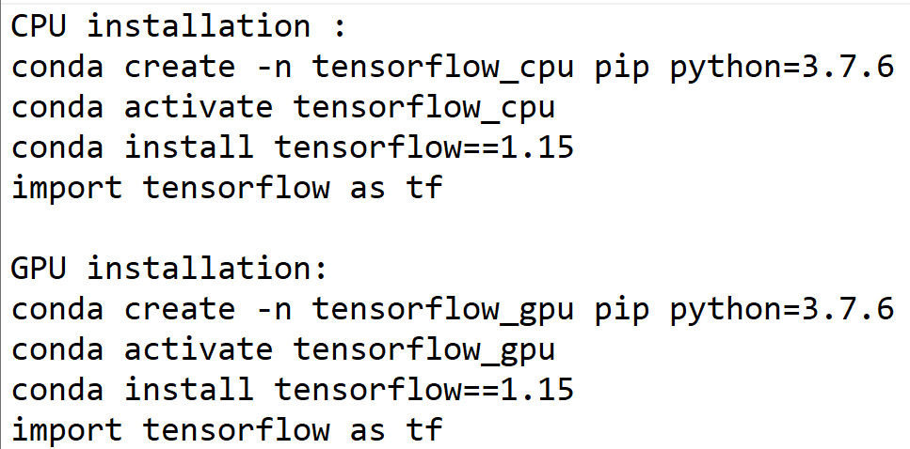
Tensorflow installation
Tensorflow CPU
Tensorflow GPU
1 of 17

Slide 4
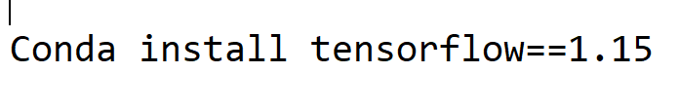
CUDA toolkit and cuDNN installation
Individual installation :
CUDA version 10.1
cuDNN version 7.6.5
Installation using cmd :
<number> of 17

Slide 5
Protobuf installation
Download the latest *-win32.zip release from website[1]
Create a folder in C:\Program Files named it Google Protobuf
Extract the contents of the downloaded *-win32.zip inside that
Add the paths in Enviroment variables
____________________________________________________________________
[1] : https://github.com/protocolbuffers/protobuf/releases
<number> of 17

Slide 6
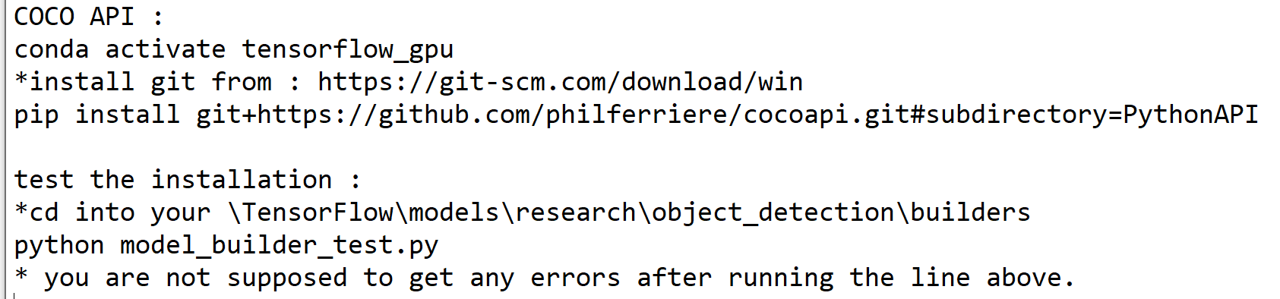
COCO API installation
First install microsoft visual studio 2015
<number> of 17

Slide 7
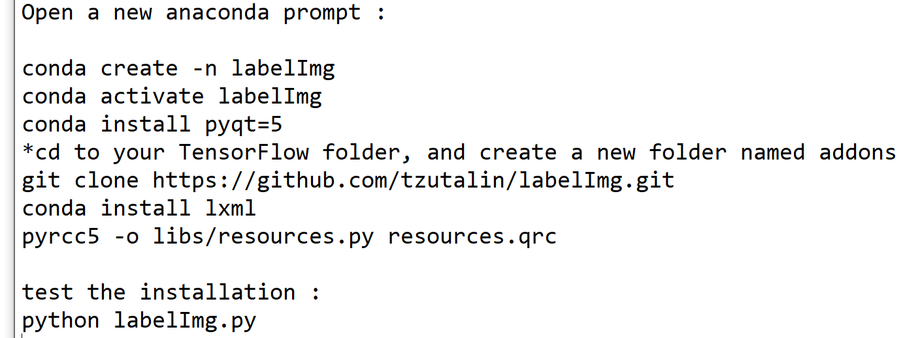
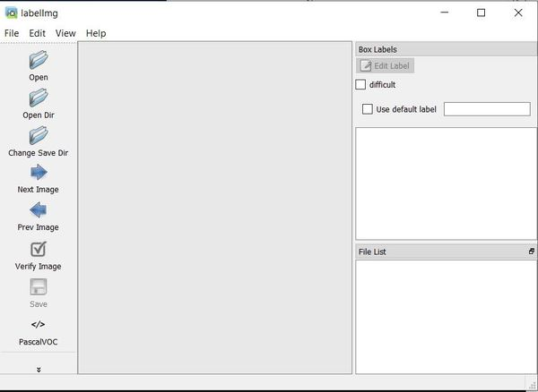
LabelImg installation
After doing the following you have to see an opening window like this →
<number> of 17

Slide 8
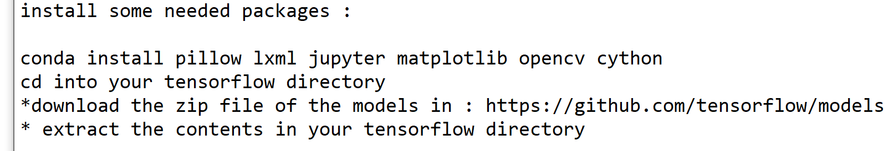
Trained models
<number> of 17

Slide 9

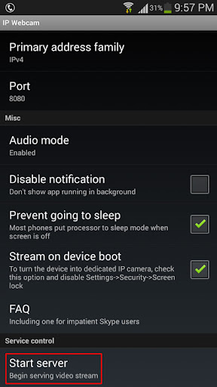
IPWebcam
Install IPWebcam on your smartphone
Open app and click on Start Server
Replace the IP address in the code with IP address in app on Smartphone and run the code
Also using any kind of IP camera is throughout the IP address without using any applications
<number> of 17

Slide 10
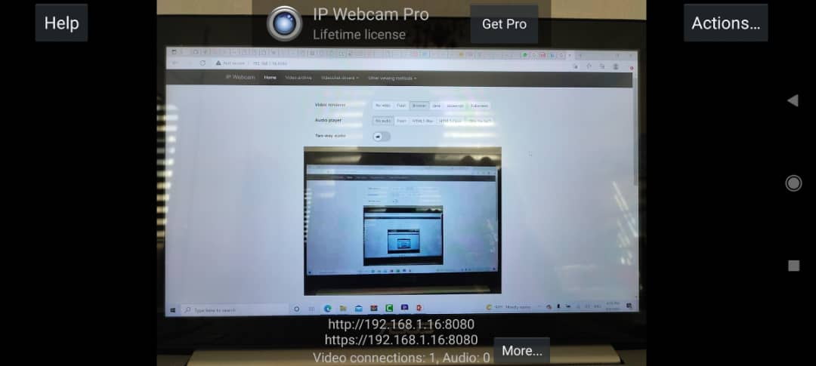
IPWebcam
<number> of 17

Slide 11
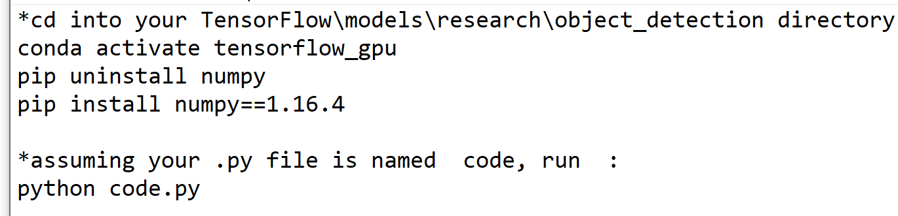
Python code
Make a .py in TensorFlow\models\research\object_detection and cd into that
<number> of 17

Slide 12
Problems and optimization
Online usage of the trained models
IP changing
Best fitted model according to the system config
Getting the image and processing time
<number> of 17

Slide 13
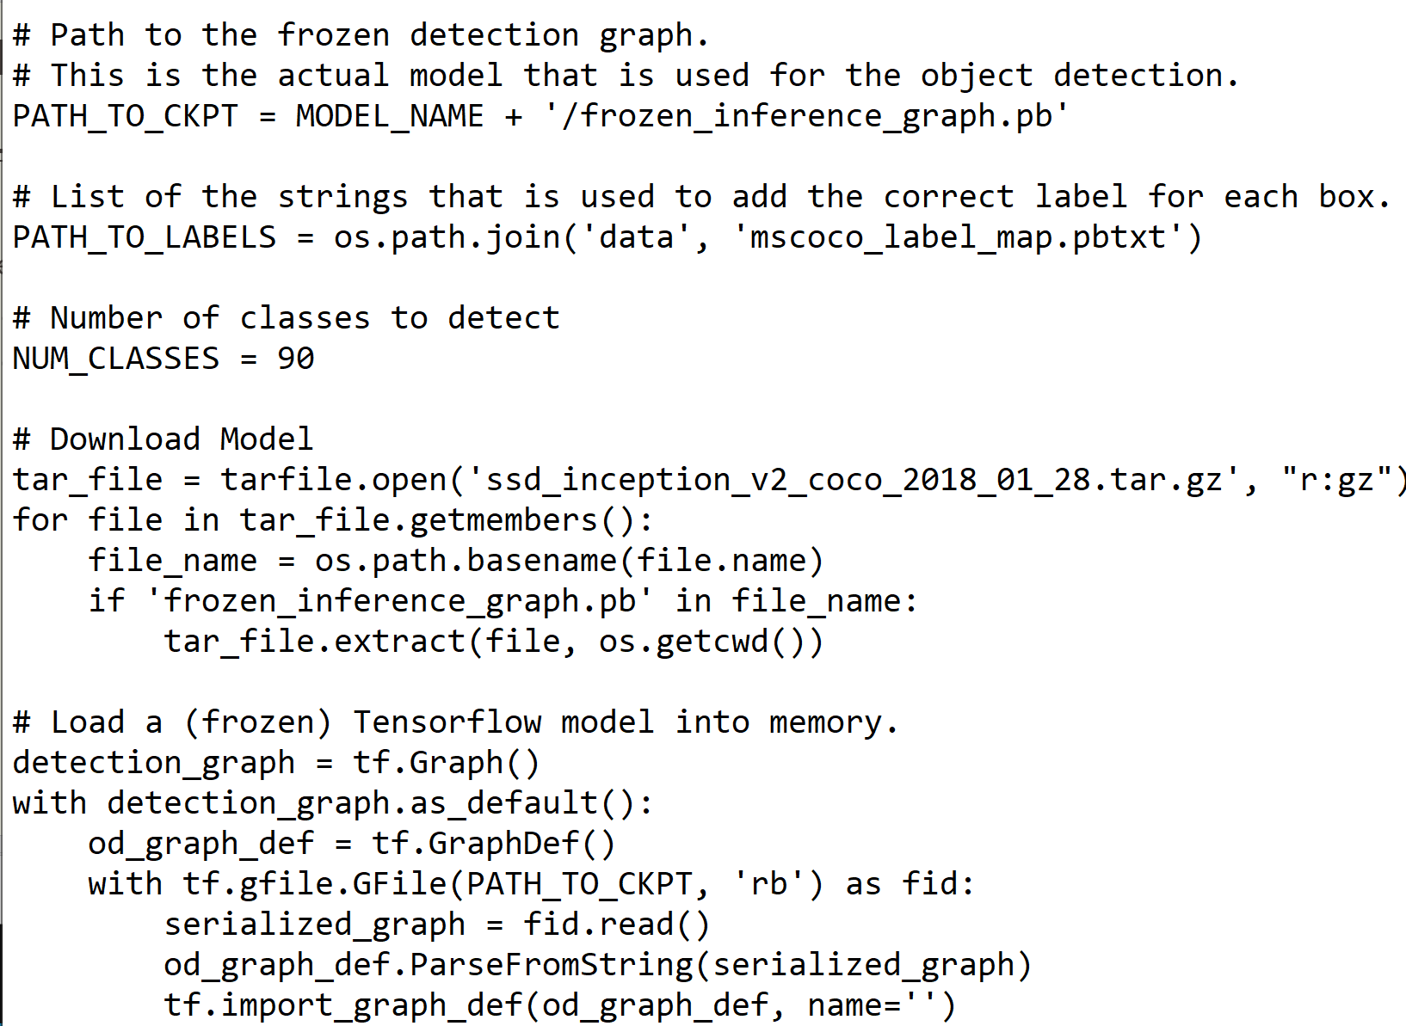
Online usage of the trained models
Issue :
Internet connection
Real-time working the models
Decreasing the smoothness
Proposed solution :
Download the models and address them in the code in order to open and extract the files needed to process them
<number> of 17

Slide 14
Best fitted model according to the system config
It is very hard to have a fair comparison among different object detectors. There is no straight answer on which model is the best. For real-life applications, we make choices to balance accuracy and speed. Besides the detector types, we need to aware of other choices that impact the performance:
Feature extractors (VGG16, ResNet, Inception, MobileNet).
Input image resolutions.
The number of proposals or predictions.
Boundary box encoding.
Data augmentation.
Training dataset.
Use of multi-scale images in training or testing (with cropping).
Which feature map layer(s) for object detection.
Localization loss function.
Deep learning software platform used.
Training configurations including batch size, input image resize, learning rate, and learning rate decay.
<number> of 17

Slide 15
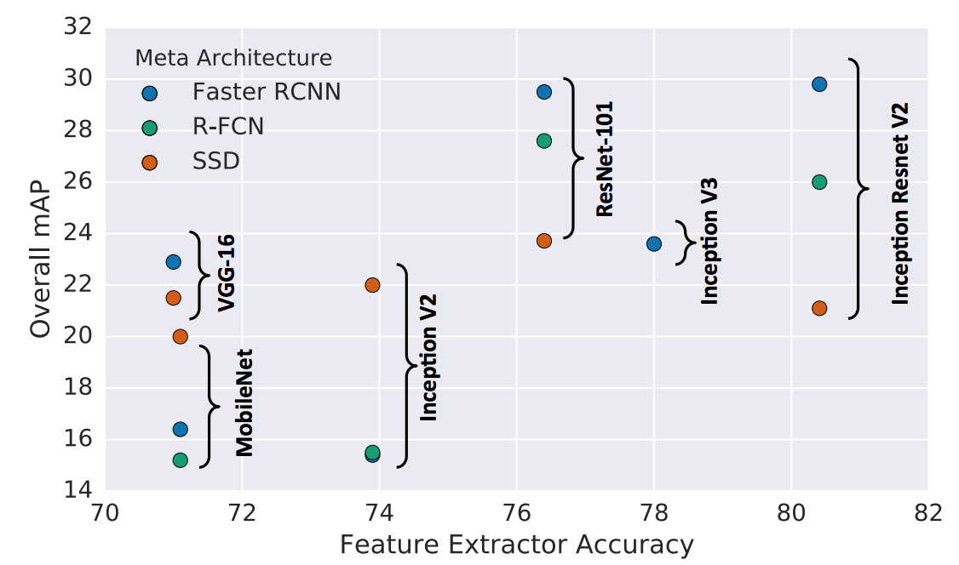
Comparison
the mean average precision (mAP) is used. The mAP compares the ground-truth bounding box to the detected box and returns a score. The higher the score, the more accurate the model is in its detections.
The SSD-inception-v2 was finally choosed after testing several architecture due to the smoothness and enough detection based on the config.
<number> of 17

Slide 16
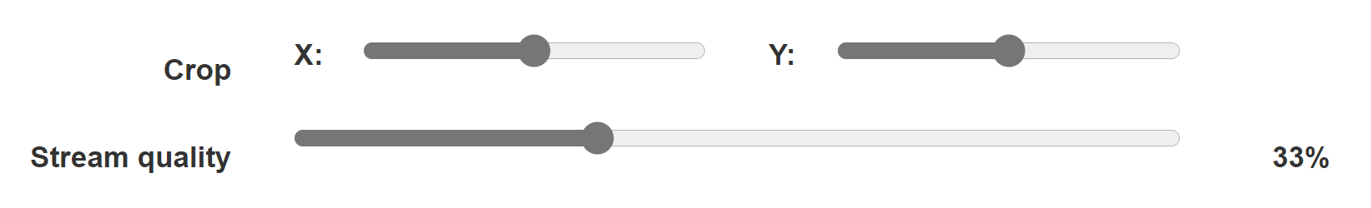
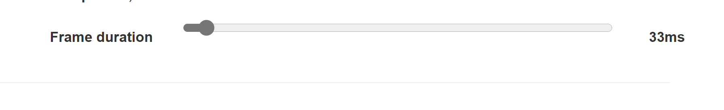
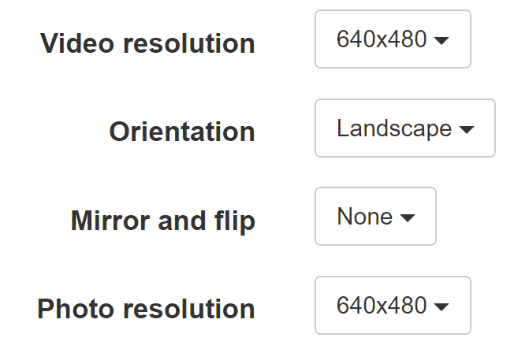
Getting the image and processing time
Issues :
Stream quality
Video and picture resolution
Frame duration
Solution :
Set stream quality, resolution and frame duration manually
<number> of 17

Slide 17
Thank you.
<number> of 17

